Slide 1
ADVENTURE WORKS
FINANce OVERVIEW, FY2004

Slide 2
CONTENTS
FY2004 KPI Overview in Numbers
KPI by Sales Type: Comparative Analysis
KPI by Product Category
Overview
By Sales Type
KPI by Country
Overview
By Sales Type
Key Takeaways
Next Steps
Q&A
Notes:
FY2004 performance remained strong and balanced, with top- and bottom- line resultes exceeding expectations.

Slide 3
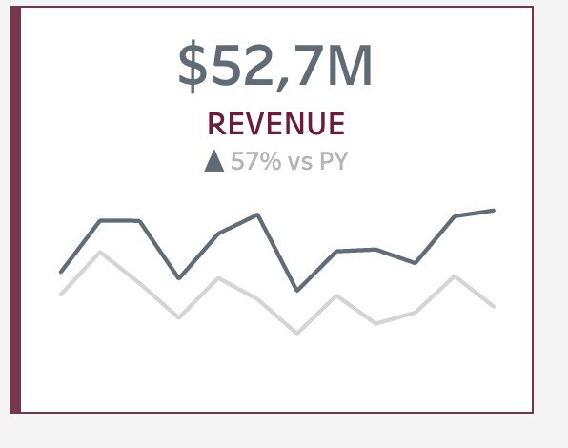
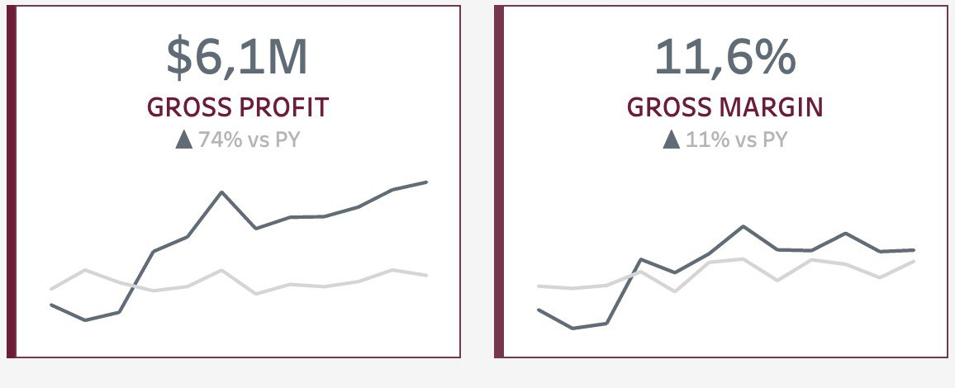
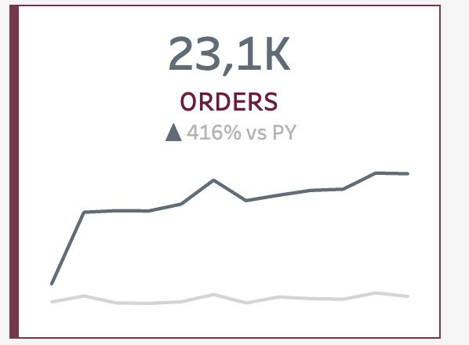
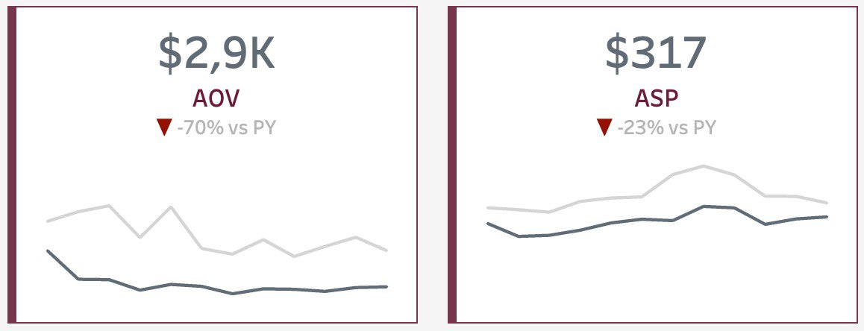
KPI OVERVIEW IN NUMBERS | FY2004, all regions
Positive growth in revenue and profitability
Significant surge in customer activity
Drop in AOV and ASP, possibly impacting profitability
Notes:
During the AOV drop period, cheaper products like accessories and clothing were added to online sales. This aligned with sales showing an increase but for lower-priced products. Inclusion of more affordable product categories in the range.
The company actually included ACC and clothing to online, so they included more product that are cheaper. Also in sales reason price also shows up. Sales increased but for very small price products.
Revenue increased steadily to $109.7 million, while gross profit rose positively to $12.5 million. However, a rise in operational expenses saw Cost of Goods Sold escalate to $97.2 million. This increase led to a decrease in Gross Margin to 11.4%, signalling a decline in profitability due to heightened production costs. Revenue Growth: The consistent growth in revenue to $109.7 million indicates positive market traction and sales performance over time.
Gross Profit Increase: Despite the revenue growth, the rise in gross profit to $12.5 million showcases improved efficiency in production or sales processes.
Cost of Goods Sold: The notable increase to $97.2 million suggests higher operational expenses, possibly impacting profitability.
Gross Margin Decline: The decrease to 11.4% indicates a decline in profitability, highlighting the pressing need to address rising production costs.

Slide 4
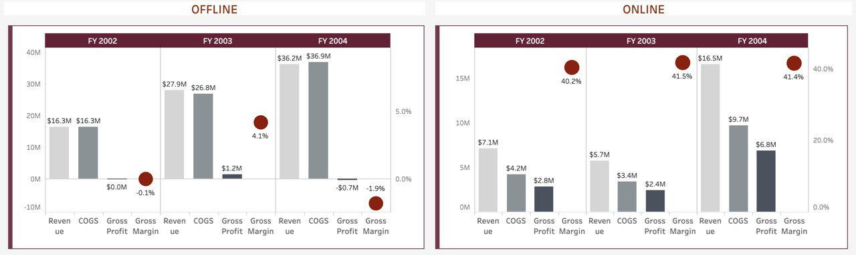
KPI by sales type | FY2002 – FY2004, all regions Comparative Analysis
Gross profit losses in Offline:
negative margin of -1.9%
profitability challenges
Online - the only driver of profitability:
significant margin of 41.4%
Notes:
Across 2002-2004, offline orders consistently drove revenue growth, reaching $36.2M, while online orders exhibited fluctuating patterns, peaking at $16.5M. However, profitability posed challenges for offline orders, resulting in a negative gross profit by 2004. In contrast, online orders showcased resilience, achieving positive gross profit growth. Both experienced cost increases in alignment with revenue, yet offline orders faced more pronounced challenges in maintaining profitability compared to the relatively stable performance of online orders.

Slide 5
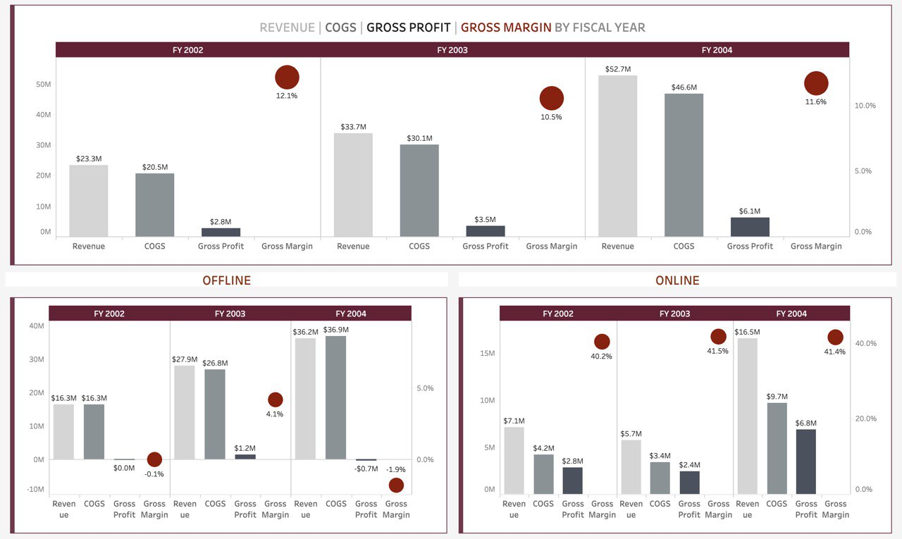
KPI by sales type | FY2002 – FY2004

Slide 6
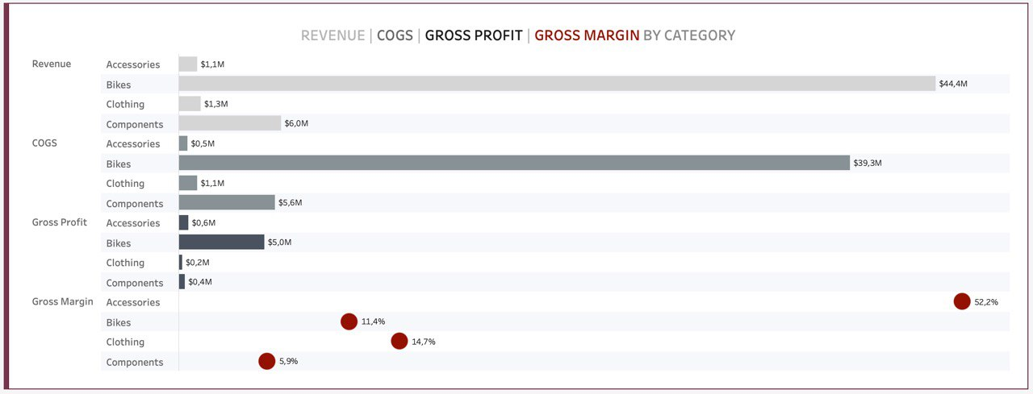
KPI by product category | FY2004, all regions overview
Bikes generated the highest revenue and gross profit
Accessories with 52.2% - the most profitable category
Notes:
Bikes: Generate a higher gross profit of $10 million but with a lower gross margin of 11%.
Accessories: Have a lower gross profit of $0.6 million but a higher gross margin of 49.5%.
While bikes contribute significantly more to the total gross profit ($10 million compared to $0.6 million), accessories have a substantially higher gross margin percentage (49.5% compared to 11%).
If the focus is solely on the total profit contributed, bikes lead with a significantly higher amount. However, if the emphasis is on the percentage of profit earned relative to the cost of goods sold, accessories have a higher margin.

Slide 7
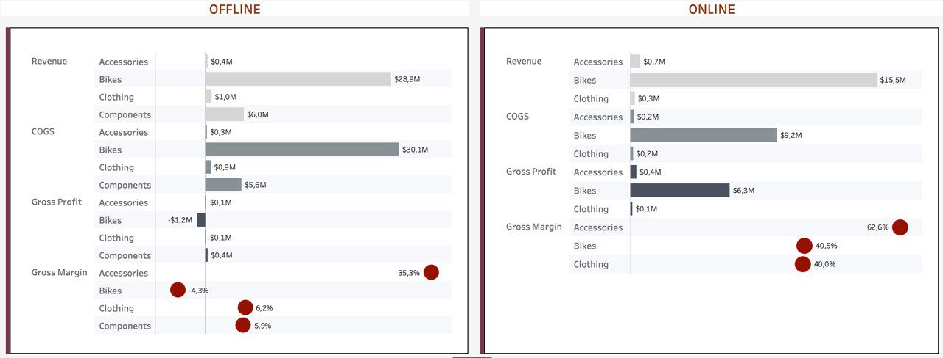
KPI by product category | FY2004, all regions by sales type
Profitability challenges in Offline
Bikes underperformed with significant gross profit loss and negative margin
Operation expenses increased due to: - significant promotional discounts - lower pricing strategies compare to Online
Notes:
Product Mix: there are no Components sold in Online channel
Revenue: Bikes is the top-selling category across both sales channels, generating $66.3m in Offline and $28.3m in Online
Profitability: in the Offline channel, lower pricing strategies compare to Online, coupled with significant promotional discounts, increased operational expenses. This impacted profitability, leading to a loss of $1m in Bike sales and resulting in a negative gross margin of -1.5%. Conversely, the Online channel consistently maintains a substantial gross margin above 40% in all categories, with Accessories achieving an impressive 62.6% gross margin

Slide 8
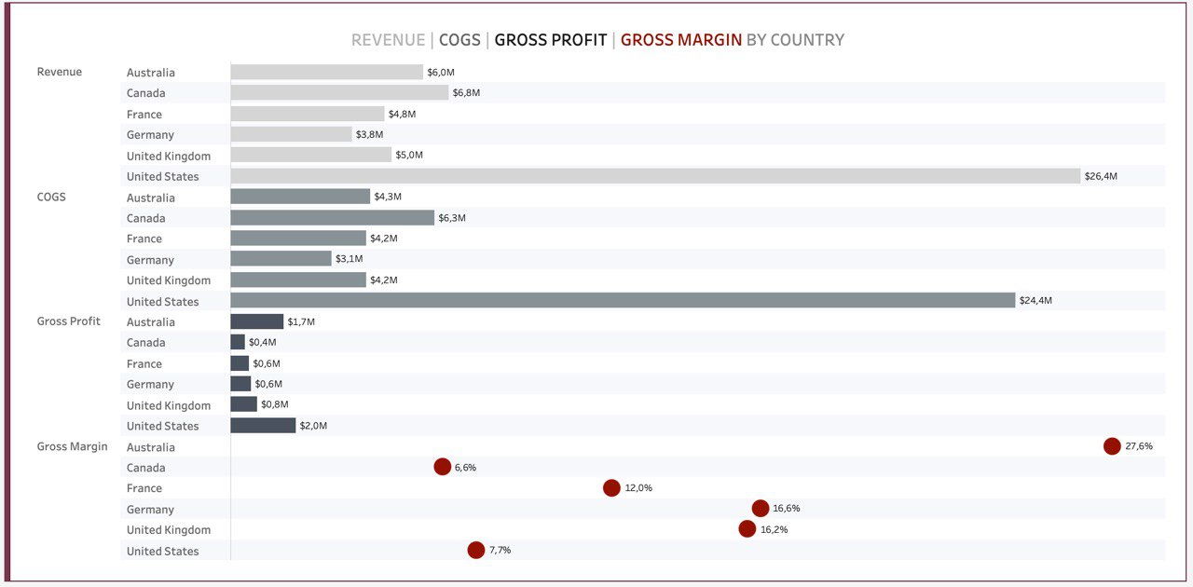
KPI by COUNTRY | FY2004 overview
Primary sales driver – the United States
Potential in underperforming Canada – similar to the United States market in North America
Consistent profitability in Australia with a substantial gross margin of 27.6%
Notes:
Revenue: The United States stands out as the primary sales driver, boasting $63 million in sales, followed by Canada with $16.3 million. Cost Dynamics: Costs in the United States surged significantly to $58.5 million, closely tracking the revenue trend. Profitability: Leading in gross profit, the United States generated $4.4 million, with Australia closely behind at $3.6 million. Gross Margin: While Australia maintains consistent profitability with a substantial gross margin of 33.5%, top-selling countries like the United States and Canada exhibit lower gross margins at 7% and 6.1%, respectively.

Slide 9
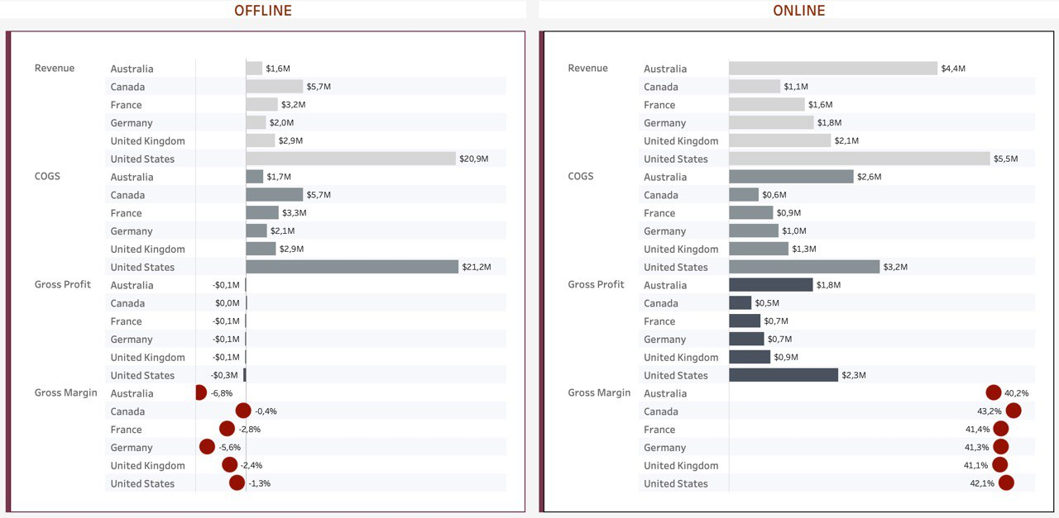
KPI by country | FY2004 by sales type
the United States lead in both channels, while Australia is second in Online
Lowest Online sales in Canada
Profitability losses in Offline where cost of goods sold (COGS) exceeds revenue
Notes:
When both gross profit and gross margin are below 0, it signifies a situation of loss or negative profitability. It's often termed as "negative profitability," indicating that the company is incurring losses from its operations. This scenario suggests that the cost of goods sold exceeds the revenue generated, resulting in an overall negative profit margin.
Territorial analysis indicates that the US is the primary driver of sales, closely followed by Canada. However, despite similarities in market potential between the US and Canada, the latter lags significantly in performance. This suggests an opportunity for a deeper exploration of the Canadian market to use the possibilities on this market. Australia is the strongest market for online orders.
Recommendations:
Focusing on boosting online sales in Australia, a strong market.
A deeper dive into the Canadian market due to its underperformance despite potential.

Slide 10
KEY takeaways
Profitability Challenges in Offline
2. Regional Performance: challenges and opportunities on Country level
Notes:
Costs Impact Profitability: COGS increased, potentially impacting overall profitability.
Changing Customer & Pricing Dynamics: AOV and ASP declined, signaling shifts in customer behavior and pricing strategies toward lower-priced items. Introduction of cheaper products online may have influenced this change.
Offline Profitability Challenges: Gross profit losses in the offline channel resulted in a negative margin of -1.9%, indicating challenges in achieving profitability.
Regional Performance Snapshot: Unveiled profitability challenges in select territories, highlighting the need for targeted strategies to enhance operational efficiency and drive profitability. Optimizing strategies in these territories for sustained expansion

Slide 11



Next steps
Profitability Growth in Offline
Regional Performance Adjustment
Implement strategies to enhance profitability and achieve positive margins in Offline sales:
Review and adjust pricing strategies
Align Offline and Online prices
Revise promotional strategies
Collaborate with Sales team to propose targeted strategies for markets with identified challenges and opportunities to improve performance and profitability:
Focus on boosting Online sales in Australia as a strong Online market
Conduct a comprehensive market exploration in Canada to address its underperformance within the North American region
Notes:
These recommendations focus on cost management, pricing strategies, product mix adjustments, and targeted improvements in the offline channel to address the highlighted challenges.
Our Commitment: Establishing a Sustainable Business Model -> Balancing (fast revenue) Growth and Profitability
Despite revenue growth, the decline in gross margin calls for a focused strategy to balance rapid expansion with maintaining profitability.
Addressing the increase in Cost of Goods Sold is crucial to improving profitability. 1. Gross Profit Margin Focus: Aiming for a 20% increase in gross profit margin by optimizing pricing and promotional strategies within our offline channel
Revenue Diversification: Targeting a 60% overall revenue increase across both channels to foster a balanced growth trajectory
Customer Value Enhancement: Driving a 30% increase in Average Order Value (AOV) to enhance overall profitability
Operational Efficiency: Identifying cost-saving opportunities and enhancing operational efficiencies to align with our growth trajectory

Slide 12
Q&A

